Slide 1

Xml

Slide 2
Extensible markup language XML stands for extensible markup language. A markup language is a set of codes, or tags, that describes the text in a digital document. The most famous markup language is hypertext markup language (HTML), which is used to format Web pages.

Slide 3
Difference between HTML and XML: There are many differences between HTML and XML. These important differences are given below:
HTML | XML
HTML stands for Hyper Text Markup Language. | XML stands for extensible Markup Language.
HTML is static. | XML is dynamic.
HTML is a markup language. | XML provides framework to define markup languages.
HTML can ignore small errors. | XML does not allow errors.
HTML is not Case sensitive. | XML is Case sensitive.
HTML tags are predefined tags. | XML tags are user defined tags.
There are limited number of tags in HTML. | XML tags are extensible.
HTML does not preserve white spaces. | White space can be preserved in XML.
HTML tags are used for displaying the data. | XML tags are used for describing the data not for displaying.
In HTML, closing tags are not necessary. | In XML, closing tags are necessary.

Slide 4
Learning objectives
Data types
Structured data
Writing XML
Markdown
XML attributes and examples
Documenting XML
Structuring data documentation

Slide 5
Definition
XML has its origins in HTML
XML is like HTML except that instead of being used to capture data for a website, it's used to capture any kind of structured data
XML has two ways of handling data called tags and attributes.

Slide 6
XML Usage
A short list of XML usage says it all −
XML can work behind the scene to simplify the creation of HTML documents for large web sites.
XML can be used to exchange the information between organizations and systems.
XML can be used for offloading and reloading of databases.
XML can be used to store and arrange the data, which can customize your data handling needs.
XML can easily be merged with style sheets to create almost any desired output.
Virtually, any type of data can be expressed as an XML document.

Slide 7


Tags XML

Slide 8
Example: (tags names must be only letters, numbers and underscores)
<musician> Our musicians</musician>
What is going between tags is content
example
<tafe>Thornlie</tafe>
<classroom>8G25</classroom>
<enabled>true</enabled>

Slide 9
Nested tags
<carcolor>
<red>301</red>
<green> 234</green>
<blue>34</blue>
</carcolor>

Slide 10
Attributes
Tags have attributes as well
Attributes have key/value pair
XML Attributes Must be Quoted
Attribute values must always be quoted. Either single or double quotes can be used.
<person gender="female">
<person gender='female'>

Slide 11
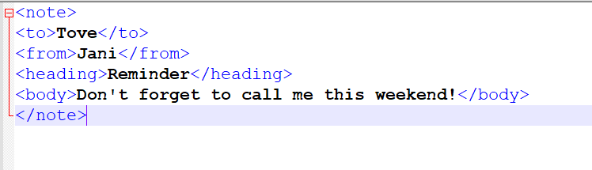
Example

Slide 12
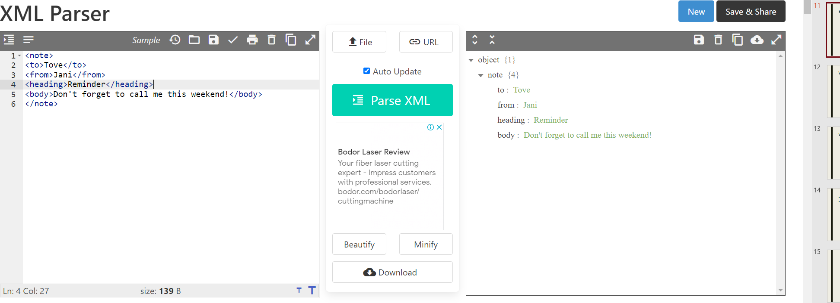

Slide 13
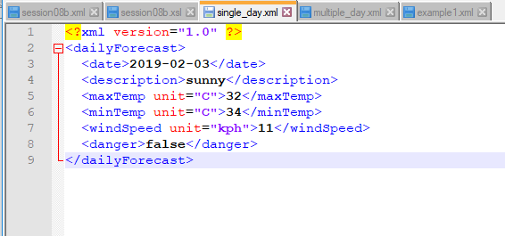

Weather Forecast: Single day

Slide 14
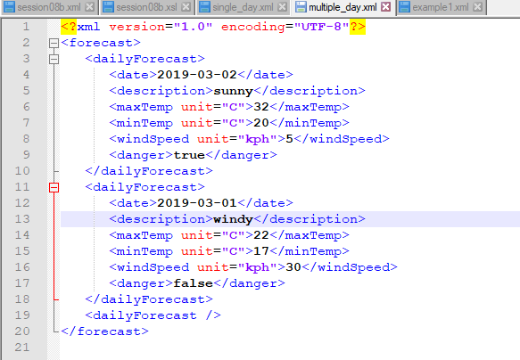
Weather forecast: multiple days

Slide 15
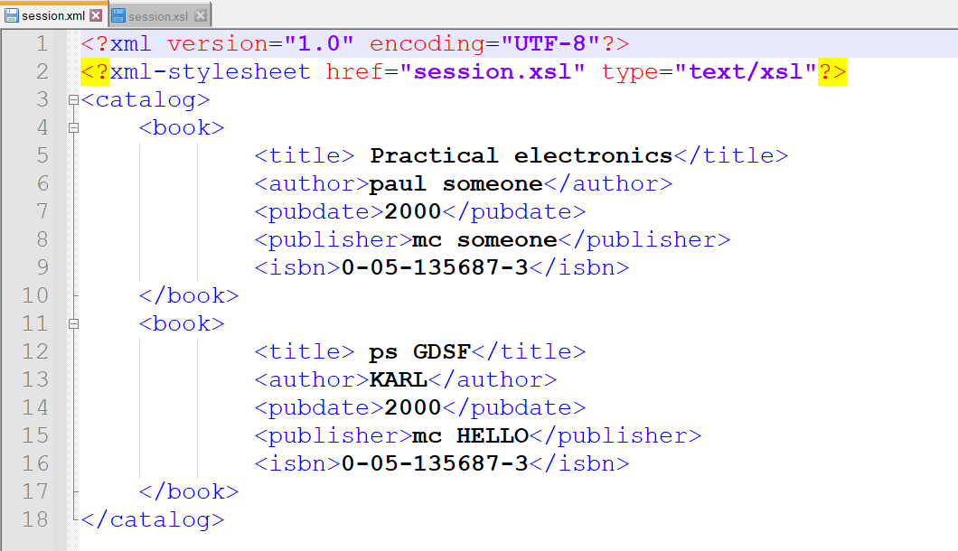

Slide 16
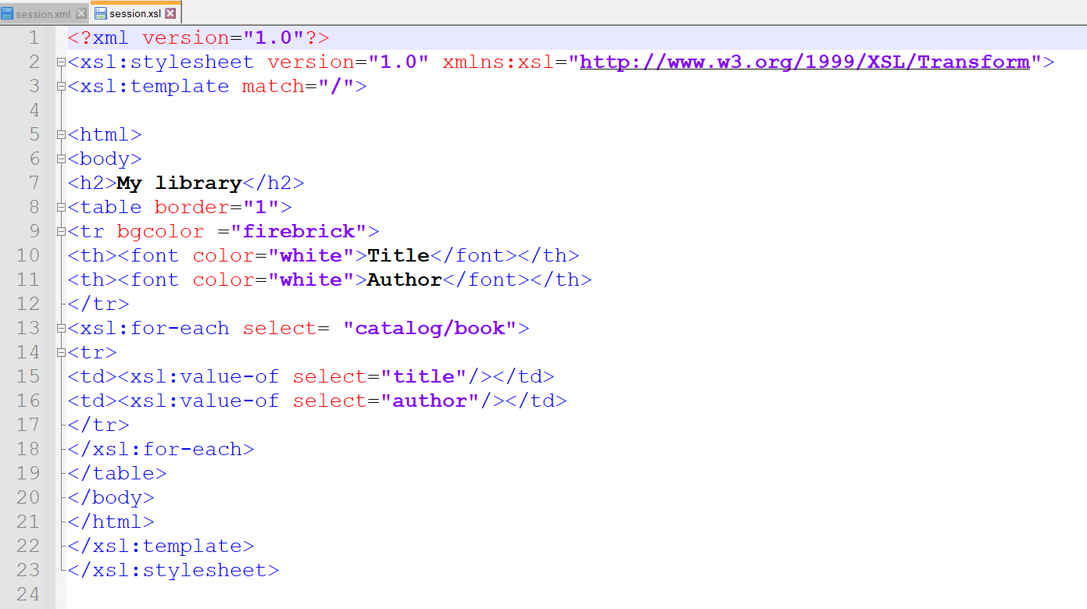

Slide 17

Lets run both files (before we need to add them to: xampp/htdocs/
We search them by the path on the server

Slide 18
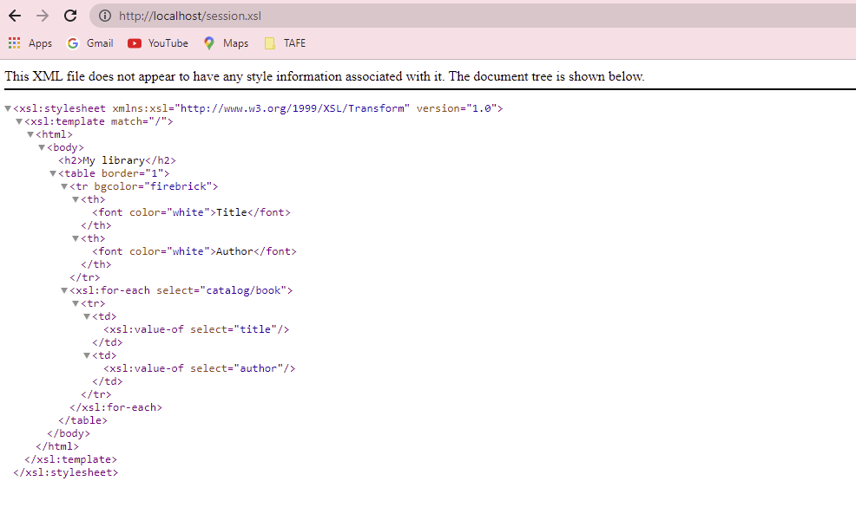

Slide 19
